Slide 1
Arduino radar project

Slide 2
THE AIM OF THIS PROJECT
This Arduino radar project aims to achieve a radar system prototype based on an Arduino board that detects stationary and moving objects. The radar system has different performance specifications, and it is also available in a variety of sizes.

Slide 3
Introduction
In this project, I will show you how to design a simple Radar Application using Arduino and Processing. This Arduino Radar Project is implemented with the help of Processing Application.
Radar is a long-range object detection system that uses radio waves to establish certain parameters of an object like its range, speed and position. Radar technology is used in aircrafts, missiles, marine, weather predictions and automobiles.
Even though the title says Arduino Radar Project, technically the project is based on Sonar technology as I will be using an Ultrasonic Sensor to determine the presence of any object in a particular range.

Slide 4
hardware
Arduino UNO
HC-SR04 Ultrasonic Sensor
SG90 Servo Motor
USB Cable (for Arduino)
Jumper Cables
Power Supply

Slide 5
SOFTWARE
Arduino IDE
Processing Application

Slide 6
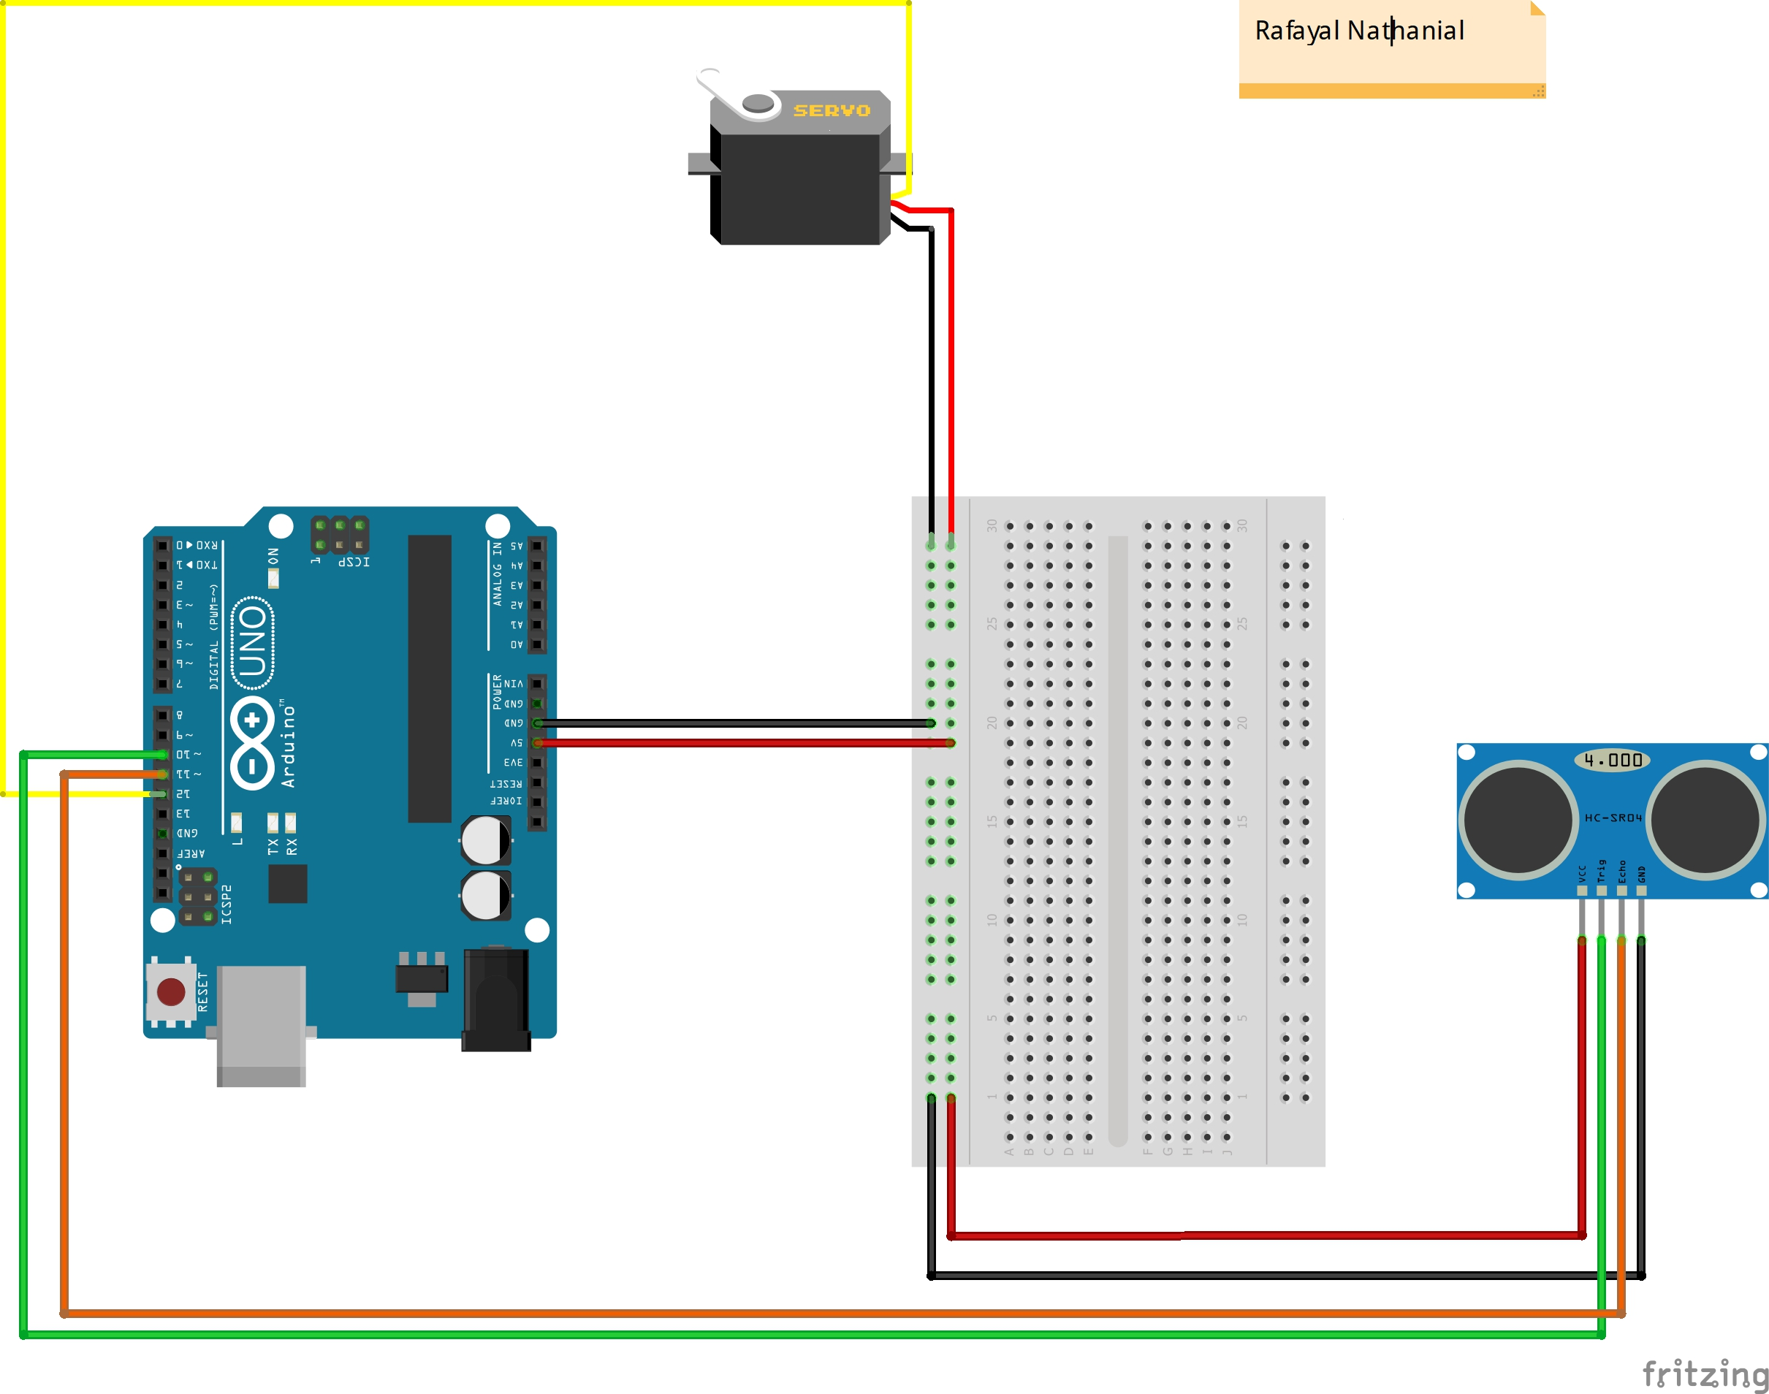
circuit diagram

Slide 7
Circuit Design
If you look at the circuit diagram, the design of the circuit for this project is very simple. The control pin of the servo is connected to Pin 12 of the Arduino while the TRIG and ECHO Pins of the Ultrasonic Sensor are connected to Pins 10 & 11 of Arduino respectively.

